Slide 1



Domino’s Website automation project
By: Pranita ambre
Guided by:amruta deore

Slide 2
Introduction
This Project aims to do overall testing like functional testing, GUI testing on Domino’s website to check quality of application using selenium web driver. It helps to improve quality of website and saves time for manually doing this testing. In this project our main focus is to test the Pizza Mania Menu Module. A Automation website is usually seeking to appeal to a broad audience and often has a Product of information to share with that audience. Software testing is an investigation conducted to provide stakeholders with information about the quality of the software product or service under test.

Slide 3
Software Requirements:
Operating System: Windows 10
Browser: Latest version of Google Chrome
Platform: Eclipse IDE
Automation Tool and Language: Selenium WebDriver, Java Files: JDK, Selenium Jar files, Common IO file

Slide 4
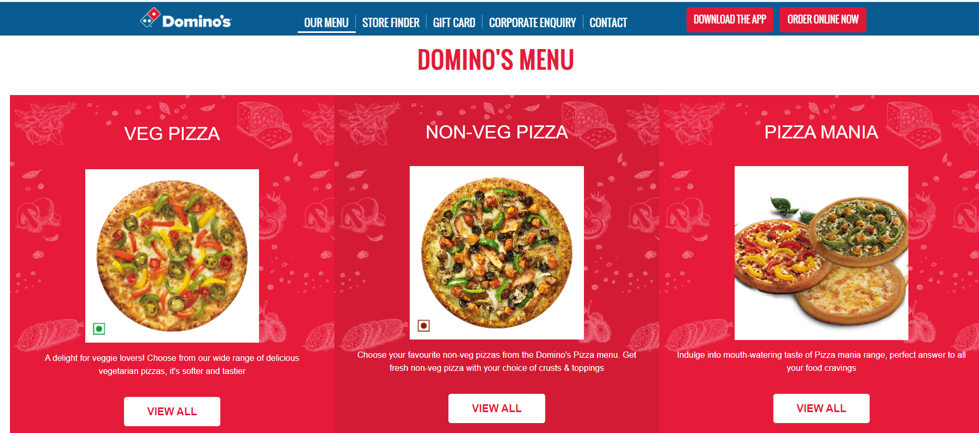
1. PIZZA MANIA MENU MODULE
System.setProperty("webdriver.chrome.driver","C:\\s eleniumwebdriver\\chromedriver\\chromedriver_win32 \\chromedriver.exe" );
WebDriver driver=new ChromeDriver(); driver.get("https://www.dominos.co.in/menu/");
driver.manage().window().maximize();
driver.get("https://www.dominos.co.in/menu/"); driver.manage().window().maximize();

Slide 5
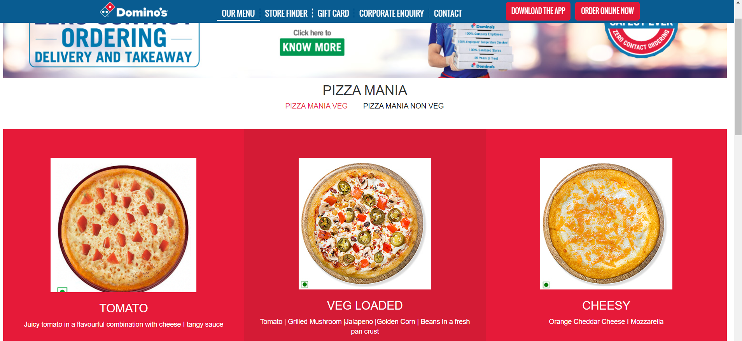
To verify the functionality of Different Veg Pizza Menu
driver.findElement(By.xpath("//*[@id=\"vegpizzas\"]/div[2]/div/div[3]/div/a")).click();
driver.findElement(By.className("imgresponsive")).click(); driver.findElement(By.xpath("//*[@id=\"pizzamania-veg\"]/div[2]/div/div[2]/div/a")).click(); driver.findElement(By.className("imgresponsive")).click();
driver.findElement(By.xpath("//*[@id=\"pizzamania-veg\"]/div[2]/div/div[3]/div/a")).click(); driver.findElement(By.className("imgresponsive")).click();
driver.findElement(By.xpath("//*[@id=\"pizzamania-veg\"]/div[2]/div/div[4]/div/a")).click(); driver.findElement(By.className("imgresponsive")).click();/driver.findElement(By.xpath("//*[@id=\"pizzamania-veg\"]/div[2]/div/div[5]/div/a")).click(); driver.findElement(By.className("imgresponsive")).click(); driver.findElement(By.xpath("//*[@id=\"pizzamania-veg\"]/div[2]/div/div[6]/div/a")).click(); driver.findElement(By.className("imgresponsive")).click();

Slide 6
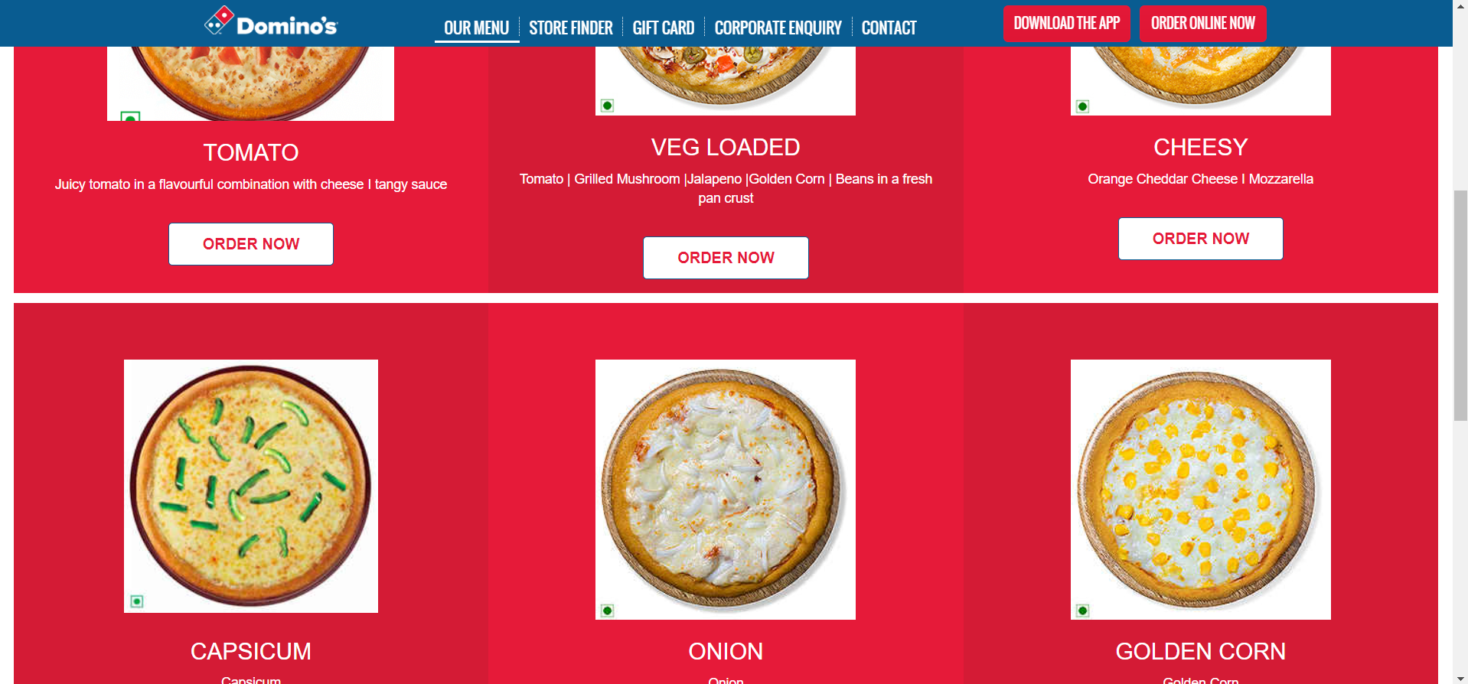
To verify the functionality of Scrollbar
JavascriptExecutor js=(JavascriptExecutor)driver; js.executeScript("window.scrollBy(0,5000)"); System.out.println("Scrolled Down"); JavascriptExecutor js1=(JavascriptExecutor)driver; js1.executeScript("window.scrollBy(0,-3000)"); System.out.println("Scrolled Up");

Slide 7
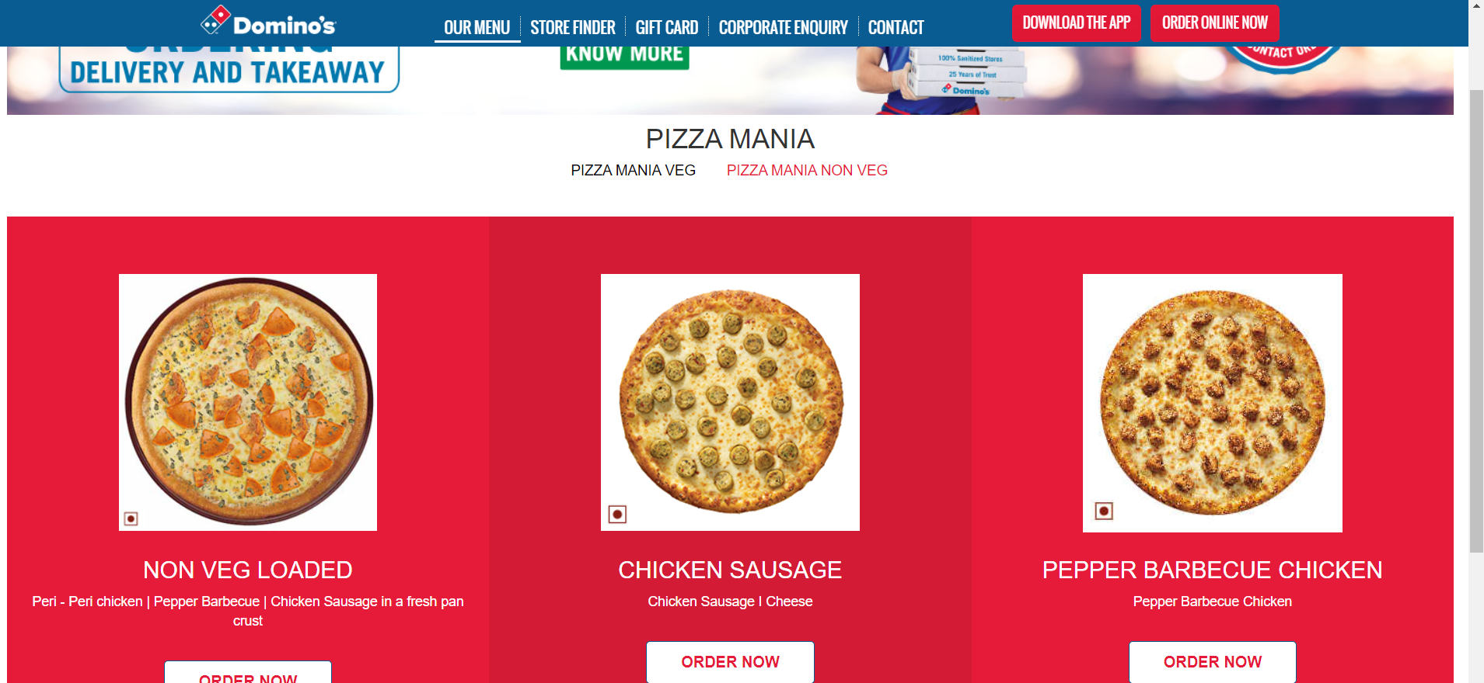
To verify the Different Non veg Pizza Menu
driver.findElement(By.xpath("//*[@id=\"pizza\"]/div[1]/ div[2]/ul/li[2]/a/h2")).click(); Thread.sleep(2000);
driver.findElement(By.xpath("//*[@id=\"pizzamania-non-veg\"]/div[2]/div/div[1]/div/a")).click(); Thread.sleep(2000); driver.findElement(By.xpath("//*[@id=\"pizzamania-non-veg\"]/div[2]/div/div[2]/div/a")).click(); Thread.sleep(2000); driver.findElement(By.xpath("//*[@id=\"pizzamania-non-veg\"]/div[2]/div/div[3]/div/a")).click(); Thread.sleep(2000)

Slide 8
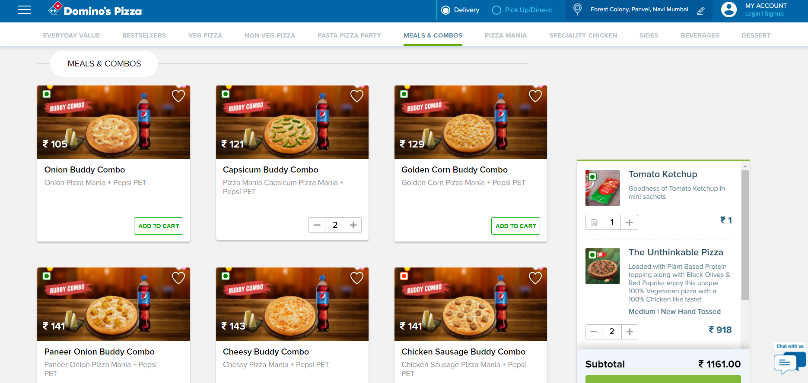
To verify and Functionality of Meals & Combo’s
System.setProperty("webdriver.chrome.driver","C:\\seleni umwebdriver\\chromedriver\\chromedriver_win32\\ch romedriver.exe" ); WebDriver driver=new ChromeDriver(); driver.get("https://pizzaonline.dominos.co.in/menu? categoryId=50"); Actions a =new Actions(driver); driver.manage().window().maximize(); //Capsicum Buddy Combo driver.findElement(By.xpath("//*[@id=\"mnlft\"]/div[10]/div/div[2]/div/div/div[2]/div[1]/span[1]") ).click(); Thread.sleep(2000); //Add to Cart driver.findElement(By.xpath("//*[@id=\"mnlft\"]/div[10]/div/div[2]/div/div/div[2]/div[2]/div/butt on/span")).click(); Thread.sleep(2000); //Increase Quantity driver.findElement(By.xpath("//*[@id=\"mnlft\"]/div[10]/div/div[2]/div/div/div[2]/div[2]/div/div[2 ]")).click(); Thread.sleep(2000); //Mini Cart Checkout driver.findElement(By.xpath("//*[@id=\"__next\"]/div/di v/div[1]/div[2]/div[2]/div[2]/div[2]/div/div/div[2]/div[ 2]/button")).click(); Thread.sleep(2000); //Place Order driver.findElement(By.xpath("//*[@id=\"__next\"]/div/di v[1]/div[2]/div[3]/div[2]/div/div[6]/div/div/div[7]/butt on/span")).click(); Thread.sleep(2000);

Slide 9
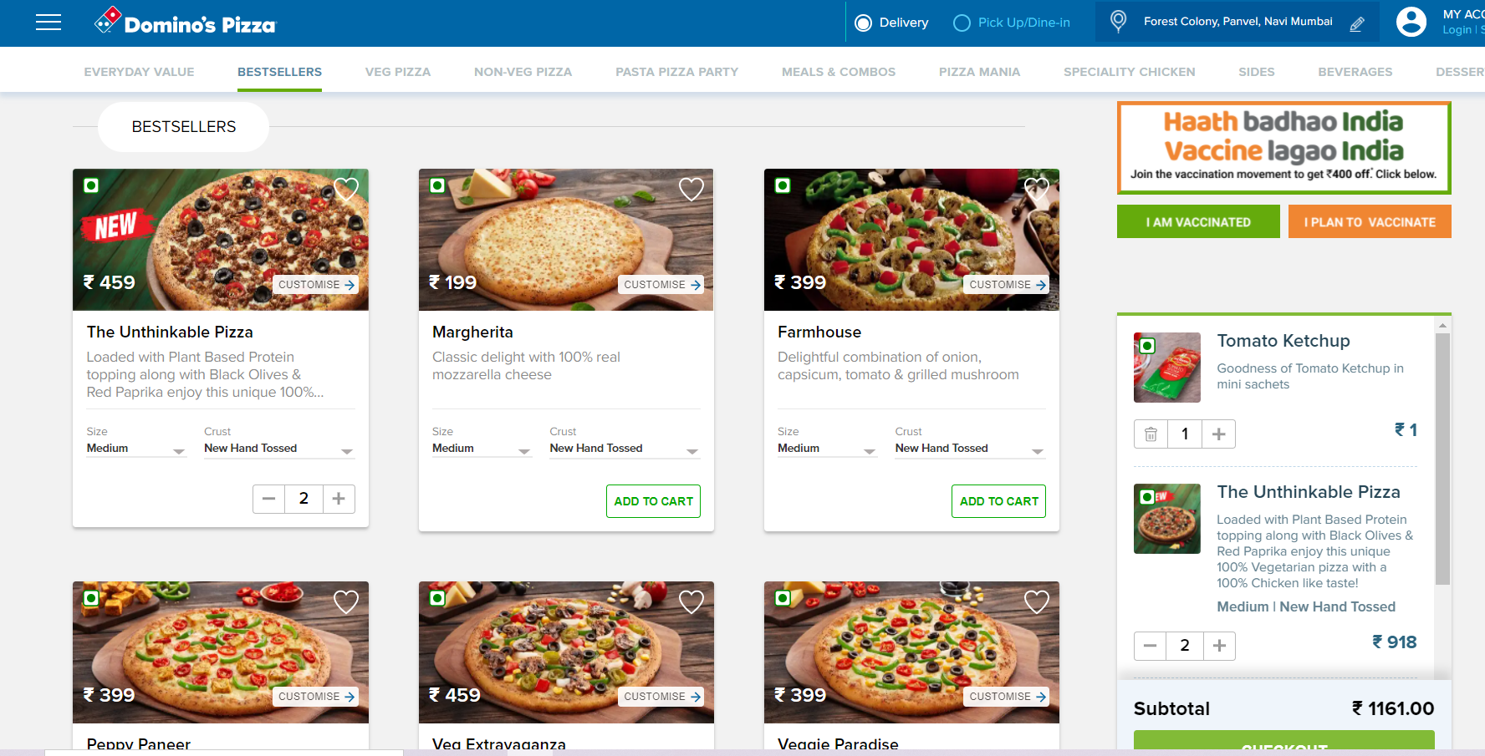
To verify and Functionality of BestSellers
System.setProperty("webdriver.chrome.driver","C:\\seleni umwebdriver\\chromedriver\\chromedriver_win32\\ch romedriver.exe" ); WebDriver driver=new ChromeDriver(); driver.get("https://pizzaonline.dominos.co.in/menu? categoryId=1"); Actions a =new Actions(driver); driver.manage().window().maximize(); //The Unthinkable Pizza driver.findElement(By.xpath("//*[@id=\"mnlft\"]/div[2]/div/div[1]/div/div/div[1]/div/div[1]/img")) .click(); Thread.sleep(2000); //Pizza Size driver.findElement(By.xpath("//*[@id=\"__next\"]/di v/div/div[1]/div[2]/div[1]/div/div[3]/div/div/div[3]/div [1]/div/div[1]/div/div[2]/div[2]")).click(); Thread.sleep(2000); //Select Crust driver.findElement(By.xpath("//*[@id=\"__next\"]/di v/div/div[1]/div[2]/div[1]/div/div[3]/div/div/div[3]/div [1]/div/div[2]/div/div/div/div/div[3]/img")).click(); Thread.sleep(2000); //SROLLBAR JavascriptExecutor js=(JavascriptExecutor)driver; js.executeScript("window.scrollBy(0,5000)"); System.out.println("Scrolled Down"); JavascriptExecutor js1=(JavascriptExecutor)driver; js1.executeScript("window.scrollBy(0,-3000)"); System.out.println("Scrolled Up"); //Add To Cart driver.findElement(By.xpath("//*[@id=\"__next\"]/di v/div/div[1]/div[2]/div[1]/div/div[3]/div/div/div[4]/div /div[2]/button/span")).click(); Thread.sleep(2000); //If you want to increase the Quantity driver.findElement(By.xpath("//*[@id=\"__next\"]/div/di v/div[1]/div[2]/div[2]/div[2]/div[2]/div/div/div[1]/div/ div/div/div[2]/div/div/div[2]")).click(); Thread.sleep(2000); //Mini Cart Checkout driver.findElement(By.xpath("//*[@id=\"__next\"]/div/di v/div[1]/div[2]/div[2]/div[2]/div[2]/div/div/div[2]/div[ 2]/button")).click(); Thread.sleep(2000); //Add Tomato Ketchup driver.findElement(By.xpath("//*[@id=\"__next\"]/div/di v[1]/div[2]/div[3]/div[1]/div/div/div[2]/div[2]/div/div/ div[2]/ul/li[2]/div/div[2]/div")).click(); Thread.sleep(2000); //Cheese Jalapeno driver.findElement(By.xpath("//*[@id=\"__next\"]/div/di v[1]/div[2]/div[3]/div[1]/div/div/div[2]/div[2]/div/div/ div[2]/ul/li[4]/div/div[2]/div")).click(); Thread.sleep(2000); //Select Coupon driver.findElement(By.xpath("//*[@id=\"__next\"]/div/di v[1]/div[2]/div[3]/div[2]/div/div[5]/div[2]/span[2]")).cl ick(); Thread.sleep(2000); //if not Applying any coupon then click on ESC driver.findElement(By.xpath("//*[@id=\"__next\"]/div/di v[1]/div[2]/div[1]/div/div[2]/span")).click(); Thread.sleep(2000); //Place Order driver.findElement(By.xpath("//*[@id=\"__next\"]/div/di v[1]/div[2]/div[3]/div[2]/div/div[6]/div/div/div[7]/butt on/span")).click(); Thread.sleep(2000);

Slide 10
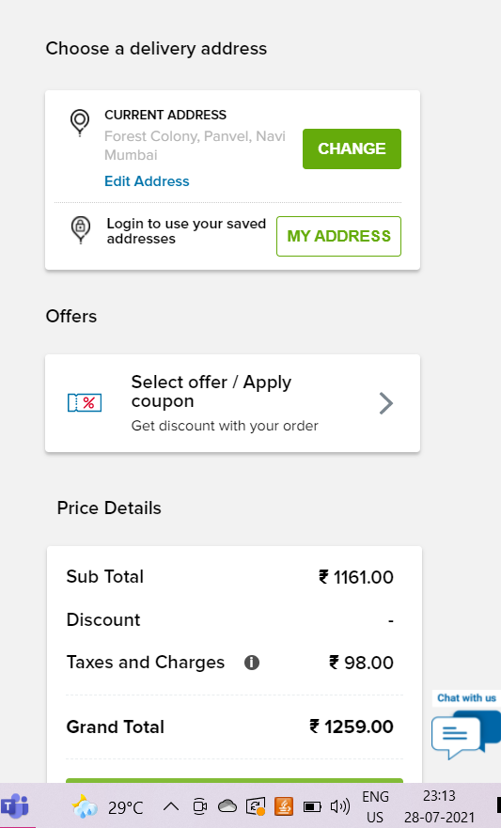
To verify and Functionality of Address and location
//ADDRESS WebElement address= driver.findElement(By.id(""));
address.sendKeys("Panvel,navi mumbai 410206"); //LOCATION
driver.findElement(By.xpath("//*[@id=\"__next\"]/div/di v[1]/div[2]/div/div[1]/div/div[3]/div/div[1]/div[2]/div[ 1]/div[2]/button/span")).click(); //SELECTION FROM LIST driver.findElement(By.xpath("//*[@id=\"__next\"]/div/di v[1]/div[2]/div/div[1]/div/div[3]/div/div[1]/div[3]/div/ div[2]/div[2]/button/span")).click()

Slide 11

Thank You

